Slide 1
Monte Carlo Algorithms in Data Science and Machine Learning
Overview of Monte carlo Methods and Discrete Mathematics
Monte Carlo Methods for Discrete Optimization
Monte Carlo Simulations
Monte Carlo Methods in Machine Learning
Advantages and Disadvantages of Monte Carlo Methods
Conclusion
Warren Birkman
CS 131 - Discrete Structures
Notes:
Hi, my name is Warren Birkman, and today I am going to be discussing Monte Carlo Algorithms in data science and machine learning.

Slide 2
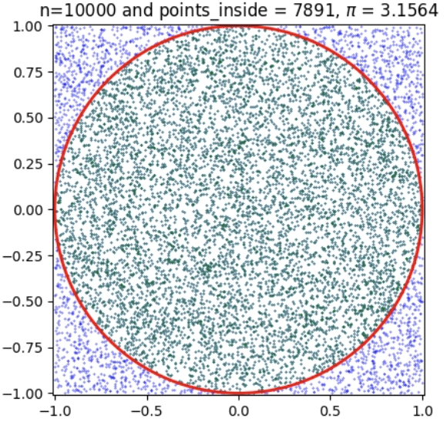
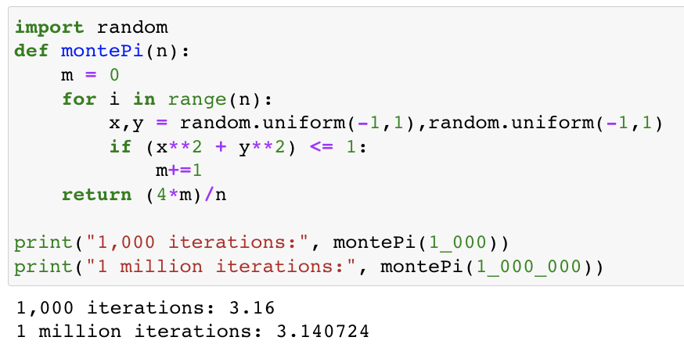
Overview of Monte Carlo Methods and Discrete Mathematics
What are Monte Carlo Algorithms
How are they useful in Data Science and ML
Calculating Pi:
Law of Large Numbers
Central Limit Theorem
Notes:
Monte Carlo algorithms are a class of probabilistic algorithms, in which they make random choices at one or more step, and always produce answers to problems with a small probability that these answers may be false.
Monte carlo algorithms solve a ton of problems that are often way to computationally intensive, as they offer a solution by exploiting randomness. Here’s an example of calculating Pi in Python using a simple Monte Carlo algorithm.
In the monte carlo algorithm above, we utilize a type of uniform random variable sampling, providing us a discrete set of options to sample from, like rolling a die, but with more complex values.
One thing to note about the example above is the Law of Large Numbers and The Central Limit Theorem:
These are important to understanding why Monte Carlo algorithms work. The law of large numbers says that the larger the sample, the closer the average of our sample will get to the expected value, hence the comparison between 1,000 points and 1 million.
The central limit theorem is one step further, saying if we kept placing points and taking the average value of (4*m)/n, we’d get a normal distribution around the actual value of pi
In machine learning and data science, discrete math provides a backbone for many algorithms with topics such as combinatorics, graph theory, and logic. Monte Carlo methods, specifically, often rely on these same concepts among some others like sampling, or navigating decision trees. In machine learning Monte Carlo algorithms can be useful for optimization problems, or decision making for reinforcement learning. In any case, the goal of machine learning is to make accurate predictions, and Monte Carlo algorithms can help us there.

Slide 3
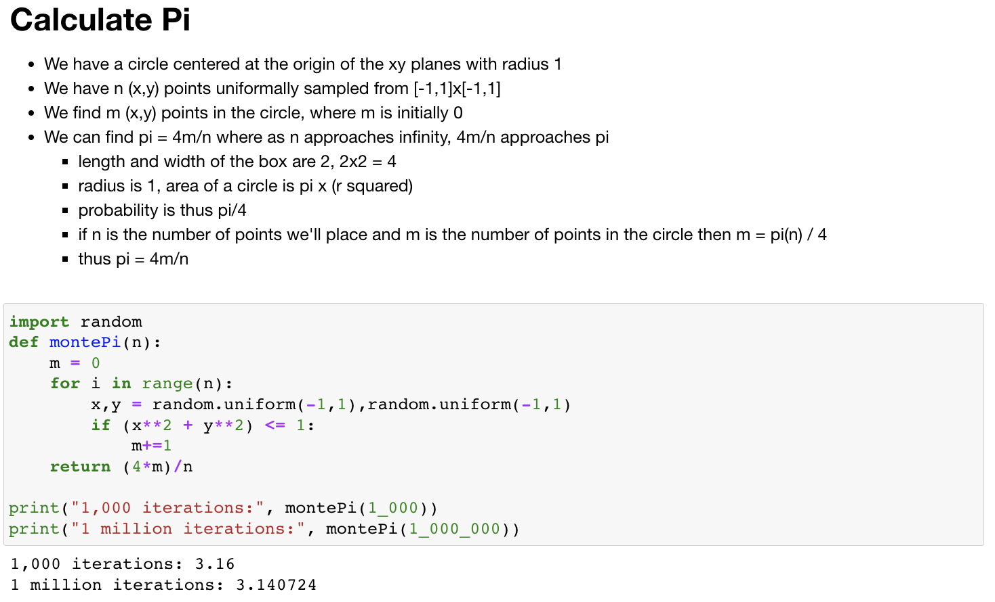
Notes:
The code for calculating pi is pretty simple, I have the math explained here. Where we have a circle of radius 1 in a square of side lengths 2, and they’re both centered at the origin.
The main points here are the law of large numbers and central limit theorem which can be seen in the output at the bottom for one thousand and one million iterations getting closer to that actual value of pi.

Slide 4
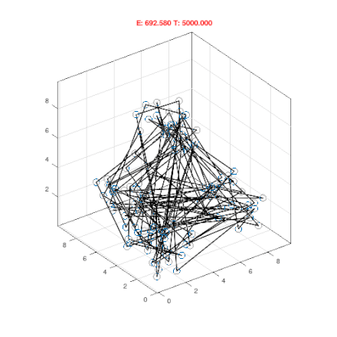
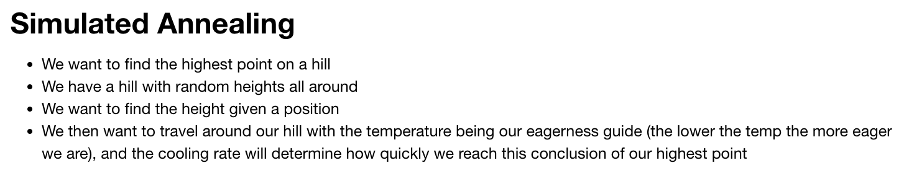
Monte Carlo Methods for Discrete Optimization
Discrete optimization problems in Data Science
Stochastic Optimization
Simulated Annealing
Comes from annealing in metallurgy
Apparent use case in solving combinatorial problems
Monte Carlo and randomness to escape local optima in a discrete solution space
Notes:
Mathematical optimization is used to select the best value for some condition, like finding the highest or lowest point on a hill. Discrete optimization deals with discrete quantities, useful for finding an optimal solution from a finite set of possible solutions, like in the case of the hill, there are n points on the hill, but only one definitive highest or lowest point of those points.
Stochastic optimization methods generate and uses random variables to approximate solutions to optimization problems. Simulated annealing is one stochastic optimization method often used in machine learning. It is a probabilistic technique used for finding an approximate global optimum. In the context of the hill scenario, imagine being blind and your goal is to find the highest point on the hill. First we would wander in random directions, accepting the possibility of descent which may lead us somewhere higher. Then we would eventually get tired of walking randomly with no definitive location as our peak, so we’d choose paths that ascend, but we wouldn’t disregard occasional descent, provided they don’t take us super far away from our current location. So in this analogy, we explore the solution space by walking around, then the algorithm becomes more eager to converge towards the best solution it has found, still maintaining a decreasing probability of exploring less optimal solutions as we are still growing eager to find that peak.
Monte carlo methods such as simulated annealing use randomness to avoid some bias to a local optima and explore more of the solution space, potentially discovering better solutions.

Slide 5
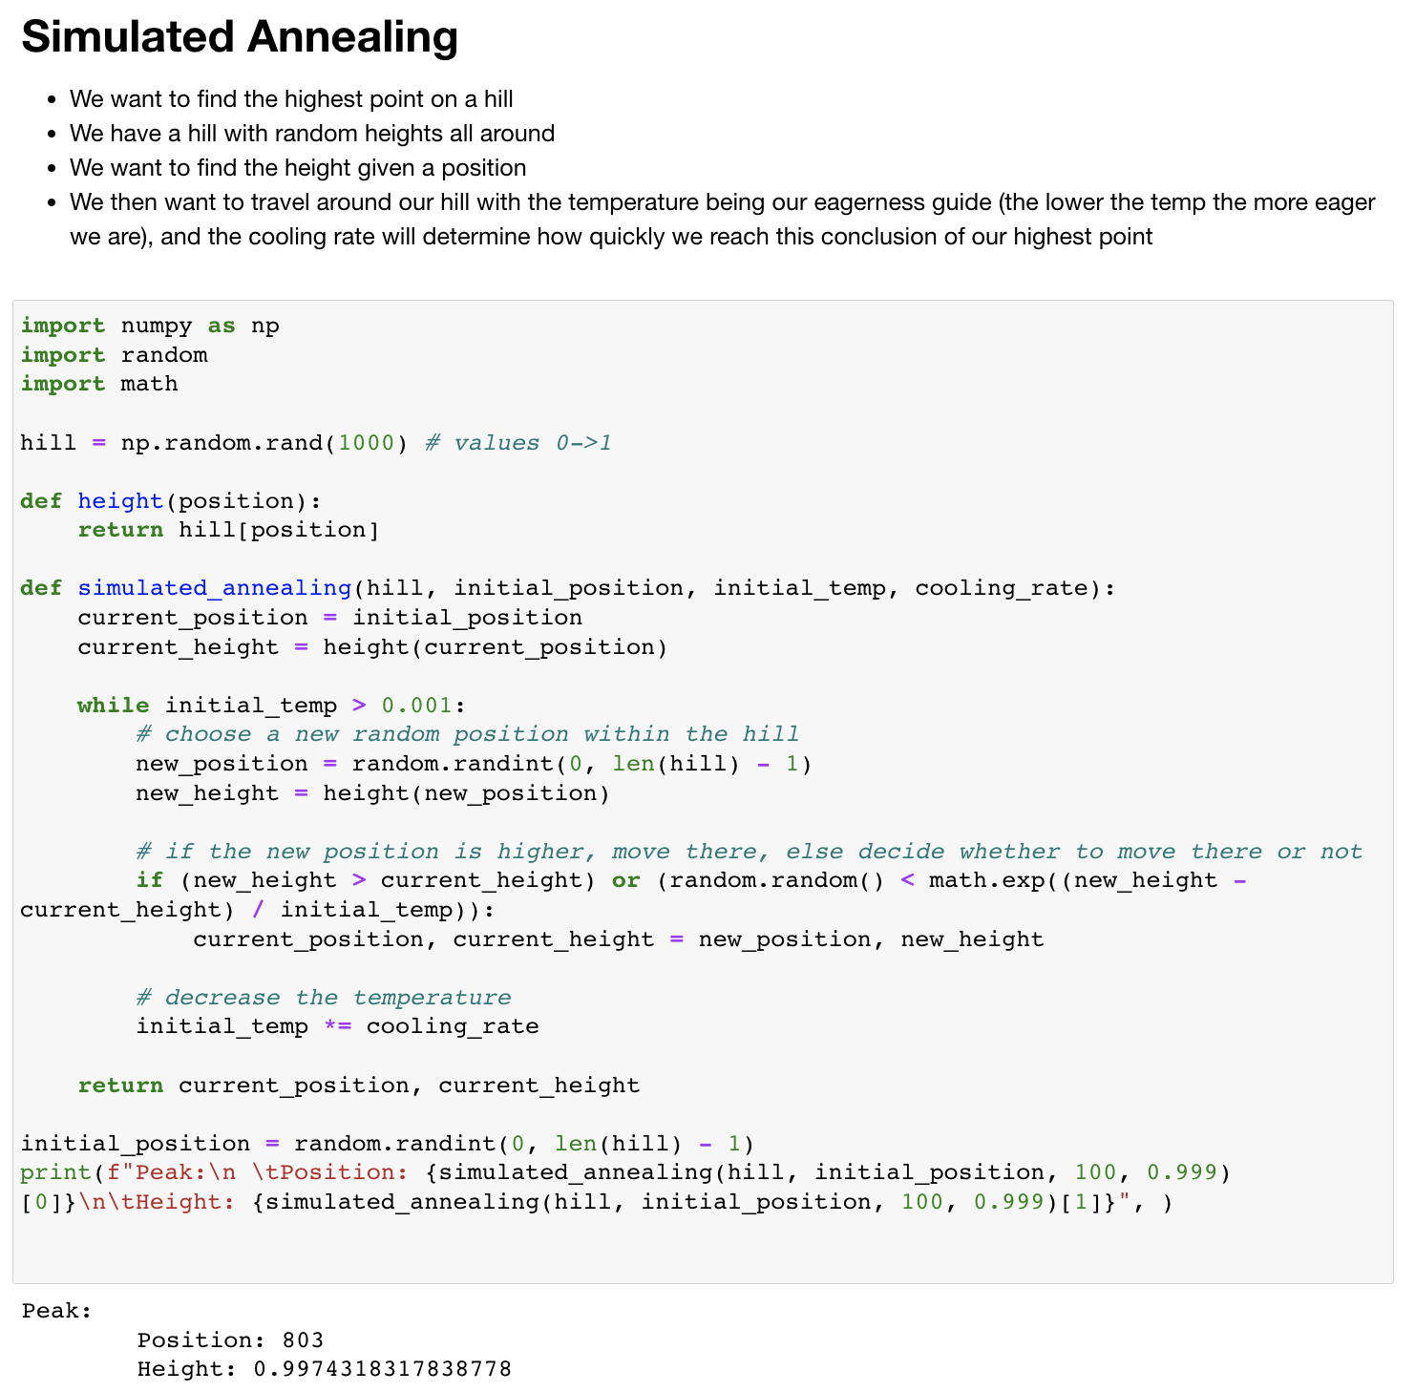
Notes:
The code for simulated annealing is a bit more complicated than the one for computing pi. In this case, we create a list of values defining heights on a hill, then we simulate traversing the hill and recording our height as we go through, favoring higher positions and maybe moving to lower positions if we aren’t as eager to get to a higher position given that our initial temp isn’t super low.

Slide 6
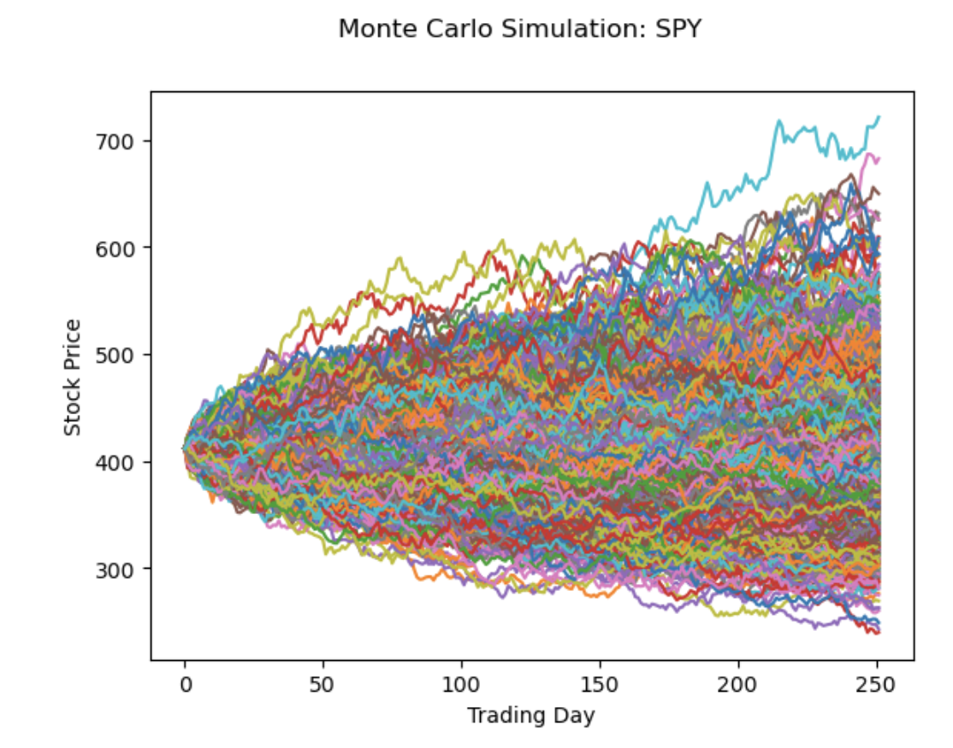

Monte Carlo Simulations
Financial markets
Risk assessment and predictive modeling
Notes:
Monte carlo simulations are a type of computational algorithm as described before, that use statistical sampling to obtain quantifiable results by modeling the probability of different outcomes in a process that cannot easily be predicted due to the presence of random variables, this it iterated upon using random inputs within set probabilistic distributions, to then create a final distribution of possible outcomes.
In financial market for example, monte carlo simulations have been used for predicting stock prices, taking into account their inherent volatility and randomness. They generate a broad spectrum of potential price paths, considering numerous possible macroeconomic scenarios and unexpected events that significantly impact companies or stocks like earnings results, product recalls, regulatory changes, etc…
I will however note that just because it has been used for this doesn’t mean it is good for it, it doesn’t guarantee complete accuracy since stock prices are inherently uncertain.
Jumping away from finance, cuz that can be boring, Monte Carlo simulations can be useful for risk assessment and predictive modeling by enabling us to calculate the risk or impact of risk in a range of models. For example: we could use a monte carlo simulation to assess the potential impact of weather on a large outdoor event by simulating various weather conditions and their potential effects on attendance.

Slide 7
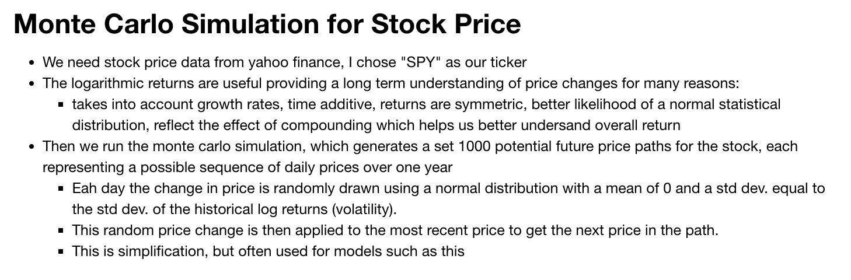
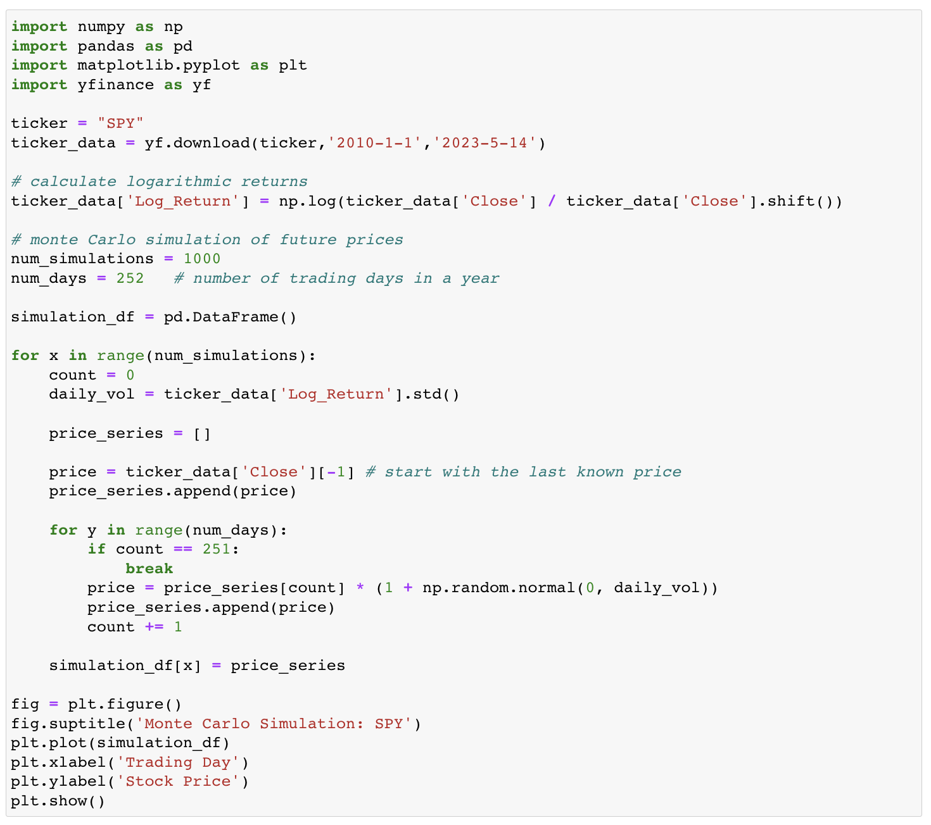
Notes:
The code for the Monte Carlo simulation for the stock price of ticker SPY which is the SPDR S&P 500 ETF if you care. We get our data for the price, then get the logarithmic returns which I explain is useful for the long term understanding of the price, then run the monte carlo simulation for the set 1 thousand iterations in which it plots 1000 future price paths for the stock, each representing a possible sequence of daily prices over one year.

Slide 8

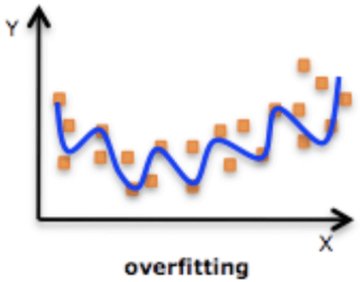
Monte Carlo Methods in Machine Learning
Monte Carlo methods in reinforcement learning
Monte Carlo Tree Search (MCTS) - Mario
Some others:
Monte Carlo Integration
Monte Carlo Markov Chains (MCMC)
Gibbs Sampling
Particle Filters
Monte Carlo Dropout in deep learning for model uncertainty estimation in a discrete setting
Notes:
Firstly, reinforcement learning can be quickly generalized by saying, “we reward good behaviors and punish bad behaviors”
By now you can imagine how monte carlo algrithms would be particularly practical or useful in reinforcement learning for their use in probabilistic inference, optimization, and decision-making. They are particularly useful in situations where there are a lot of unknowns and complex situations that could arise.
Monte Carlo Tree search (MCTS) is a search algorithm I found interesting for its application in board games and video games, as its been combined with neural networks for this purpose since around 2016. There are many more algorithms used in machine learning, this is just one of many I felt like talking about, if you’re interested in others. MCTS is used in decision making processes when it may take too long to explore all the possible ways of going about a process or in other words the decision tree.
MCTS starts with a root node being the current state, so like Mario running towards a goomba and a mushroom next to it, the root node would say Mario is a certain distance from the goomba and the mushroom, the child nodes would represent possible next states, recall combinations and permutations, mario could jump move right or stay still in this case, the best child node is selected based on a balance of possible new actions with the goal of gathering more information and information already gathered about actions that have a high win rate, and this process continue until it reaches a node that hasn’t been fully explored. Once a less explored node has been selected, Mario jumps and a new child node is added to represent the new state of the game after this decision. At this new state, MCTS simulates a random sequence of moves until it reaches a terminal node, which could be mario squashing the goomba, getting hit by the goomba, or getting the mushroom. Finally, the outcome of the simulation, which we’ll say is mario getting hit by the goomba, will update the statistics of each node along the path from the selected node to the root. This means that the MCTS learns from the simulation, it got a negative result so it will now make a better decision in future iterations, like maybe jumping over the goomba.
Now, Monte Carlo Dropout is a method to measure the error of a prediction, or the uncertainty. It’s useful for preventing overfitting which is when a model is too close to training data and thus makes inaccurate prediction on new data. Dropout is when neurons are turned off in training which helps the model work with all the needed neurons as a whole and not become bias. Monte carlo dropout is applied during training and testing, which means for each test input we get slightly different predictions each time we run it through the model. With this, we get a distribution of outputs for each test input telling us the variation in the network’s predictions with dropout. This can help us model uncertainty about predictions, like if the outputs for a given input are widely spread it might mean that the model is uncertain about the prediction for that input, or vice versa.

Slide 9

Advantages and Disadvantages of Monte Carlo Methods
Flexibility
High dimensional problems
Computational Time
Inaccurate because of sample size
Notes:
Flexibility:
Monte carlo methods are useful for a plethora of things, so you can run a monte carlo simulation on just about anything your heart desires
Monte carlo algorithms are also really good in problems with a high number of variables, take the case of stocks with stock prices dating back to 2010, you could do the same thing taking into account a wide arrange of other data for the same time frame
Computation time:
Monte carlo methods do however require a large number of samples to provide accurate estimates which can take a while to crunch out. In the case of calculating pi, the only reason I didn’t go for 1 trillion iterations is because it was taking my computer way too long
Monte carlo algorithms, as stated, are pretty reliant on the number of samples, that being said the estimates may be inaccurate for smaller samples sizes. It may also be hard to determine whether the number of samples used is sufficient, particularly for complex models. Monte carlo algorithms also pose some level risk in this regard, where someone may have a cognitive bias towards a pattern where there is just not enough data to make it obvious that the pattern isn’t a pattern at all, so the random pattern is perceived as significant.

Slide 10
Conclusion
Monte Carlo methods help us understand the unknown
Github link in description of video
Notes:
So this is the end of my presentation, I hope you all enjoyed and learned something new, and maybe found monte carlo algorithms a bit more interesting as I know the book didn’t go into immense detail. Thanks!

Slide 11
Works cited
G., T. "Monte Carlo Tree Search - Beginners Guide." Int8, 24 Mar. 2018, int8.io/monte-carlo-tree-search-beginners-guide/#Policy_network_training_in_Alpha_Go_and_Alpha_Zero Accessed 14 May 2023.
Oleszak, Michał. "Monte Carlo Dropout." Towards Data Science, 20 Sep. 2020, towardsdatascience.com/monte-carlo-dropout-7fd52f8b6571. Accessed 13 May 2023.
Rosen, Kenneth H. Discrete Mathematics and Its Applications. 8th ed., McGraw-Hill Education, 2017.
Roy, Baijayanta. "Monte Carlo Learning, Reinforcement Learning using Monte Carlo Method." Towards Data Science, 12 Sep. 2019, towardsdatascience.com/monte-carlo-learning-b83f75233f92. Accessed 13 May 2023.
"What is Monte Carlo Simulation?" IBM, www.ibm.com/topics/monte-carlo-simulation. Accessed 13 May 2023.
"What is Overfitting?" IBM, www.ibm.com/topics/overfitting. Accessed 14 May 2023.
"What is Simulated Annealing?" MathWorks, www.mathworks.com/help/gads/what-is-simulated-annealing.html. Accessed 14 May 2023.

